Slide 1
Week 7
Natural Language Processing II

Slide 2
Test corrections can be put in the folder on the front table (test face down)

Slide 3
Agenda
Attention & Transformers
Attention Fundamentals
Transformer Architecture
Popular Implementations (BERT, GPT)
Applied NLP
Text Similarity
Text Summarization
Topic Modeling
Advanced Topics
LLMs
Multimodal models (CLIP)

Slide 4
Representing Text
bank of the river
[34, 56, 24, ….. 23, 56]
?

Slide 5
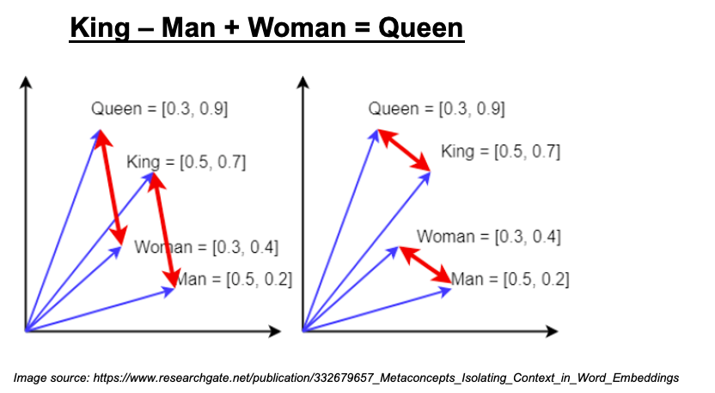
Representing Text
Word embeddings (i.e. Word2Vec)!
Getting better, but static embeddings still lack contextual awareness.

Slide 6
The Same Challenges
bank of the river
[34, 56, 24, ….. 23, 56]
deposited money at the bank
[51, 22, 19, ….. 40, 95]

Slide 7
Attention & Transformers
Conceptual understanding of self attention, multi-head attention, and cross-attention
Applied attention (transformer architecture)

Slide 8
Self Attention
bank
of
the
river
v₁
v₂
v₃
v₄
← Vector Embeddings
Goal: Improve embeddings with context

Slide 9
Self Attention
bank
of
the
river
v₁
v₂
v₃
v₄
← Vector Embeddings
Improve embeddings with context
y₁
y₂
y₃
y₄
← New representations that are better than original embeddings

Slide 10
Self Attention
bank
of
the
river
v₁
v₂
v₃
v₄
← Vector Embeddings
Improve embeddings with context
y₁
y₂
y₃
y₄
← New representations that are better than original embeddings

Slide 11
Self Attention
bank
of
the
river
v₁
v₂
v₃
v₄
← Vector Embeddings
Improve embeddings with context
y₁
y₂
y₃
y₄
← New representations that are better than original embeddings
v₁ . v₁ = s₁₁
v₁ . v₂ = s₁₂
v₁ . v₃ = s₁₃
v₁ . v₄ = s₁₄
→
dot product

Slide 12
Self Attention
bank
of
the
river
v₁
v₂
v₃
v₄
← Vector Embeddings
Improve embeddings with context
y₁
y₂
y₃
y₄
← New representations that are better than original embeddings
v₁ . v₁ = s₁₁
v₁ . v₂ = s₁₂
→ normalize (via softmax)
all weights need to sum to 1
w₁₁
w₁₂
w₁₃
w₁₄
v₁ . v₃ = s₁₃
v₁ . v₄ = s₁₄
→
dot product

Slide 13
Self Attention
bank
of
the
river
v₁
v₂
v₃
v₄
← Vector Embeddings
Improve embeddings with context
y₁
y₂
y₃
y₄
← New representations that are better than original embeddings
→
w₁₁v₁ + w₁₂v₂ + w₁₃v₃ + w₁₄v₄ = y₁
← Reweighs all vectors towards v1, so river influences bank and vice-versa

Slide 14
Self Attention
w₁₁
w₁₂
w₁₃
w₁₄
w₁₁v₁ + w₁₂v₂ + w₁₃v₃ + w₁₄v₄ = y₁
These are called “weights” because they allow us to re-weigh all the vectors.
These are NOT trainable weights.

Slide 15
Self Attention
bank
of
the
river
v₁
v₂
v₃
v₄
w₁₁v₁ + w₁₂v₂ + w₁₃v₃ + w₁₄v₄ = y₁
w₂₁v₁ + w₂₂v₂ + w₂₃v₃ + w₂₄v₄ = y₂
w₃₁v₁ + w₃₂v₂ + w₃₃v₃ + w₃₄v₄ = y₃
w₄₁v₁ + w₄₂v₂ + w₄₃v₃ + w₄₄v₄ = y₄
Improve embeddings with context
→
y₁
y₂
y₃
y₄
Order has no influence
Proximity has no influence
Shape independent (long or short sequences work)

Slide 16
Self Attention
bank
of
the
river
v₁
v₂
v₃
v₄
←
←
←
←
DOT PRODUCT
←
v₁
s₁₁
s₁₂
s₁₃
s₁₄
←
←
←
←
NORMALIZE
w₁₁
w₁₂
w₁₃
w₁₄
←
←
←
←
WEIGHTED SUM
←
v₁
v₂
v₃
v₄
y₁
y₂
y₃
y₄

Slide 17
Self Attention
bank
of
the
river
No weights are being trained so far.
What happens if we introduce trainable parameters?
v₁
v₂
v₃
v₄
←
←
←
←
DOT PRODUCT
←
v₁
s₁₁
s₁₂
s₁₃
s₁₄
←
←
←
←
NORMALIZE
w₁₁
w₁₂
w₁₃
w₁₄
←
←
←
←
WEIGHTED SUM
←
v₁
v₂
v₃
v₄
y₁
y₂
y₃
y₄

Slide 18
Self Attention
bank
of
the
river
v₁
v₂
v₃
v₄
←
←
←
←
DOT PRODUCT
←
v₁
s₁₁
s₁₂
s₁₃
s₁₄
←
←
←
←
NORMALIZE
w₁₁
w₁₂
w₁₃
w₁₄
←
←
←
←
WEIGHTED SUM
←
v₁
v₂
v₃
v₄
y₁
y₂
y₃
y₄

Slide 19
Self Attention
Introduce Query parameters, Key parameters, and Value parameters.
bank
of
the
river
KEYS
v₁
v₂
v₃
v₄
←
←
←
←
DOT PRODUCT
QUERY
My query: I want v₁ to get more context
←
v₁
s₁₁
s₁₂
s₁₃
s₁₄
←
←
←
←
NORMALIZE
When I combine Query and Keys, I want to get back the values
VALUES
w₁₁
w₁₂
w₁₃
w₁₄
←
←
←
←
WEIGHTED SUM
←
v₁
v₂
v₃
v₄
y₁
y₂
y₃
y₄

Slide 20
Now we have parameters we can train over.
Self Attention
v_{i} = 1 x k
M = k x k
[ ] = 1 x k
bank
of
the
river
KEY MATRIX
v₁M_{K}
v₂M_{K}
v₃M_{K}
v₄M_{K}
←
←
←
←
DOT PRODUCT
QUERY MATRIX
←
v₁M_{Q}
s₁₁
s₁₂
s₁₃
s₁₄
←
←
←
←
NORMALIZE
w₁₁
w₁₂
w₁₃
w₁₄
VALUE MATRIX
←
←
←
←
WEIGHTED SUM
←
v₁M_{V}
v₂M_{V}
v₃M_{V}
v₄M_{V}
y₁
y₂
y₃
y₄

Slide 21
Self Attention Block
KEYS
LINEAR
v₁
...
v_{n}
MATMUL
s_{ij}
NORMALIZE
QUERIES
Dot product
w_{ij}
LINEAR
VALUES
v_{i}
LINEAR
MATMUL
Weighted Sum
y₁
...
y_{n}

Slide 22
Self Attention
TL;DR
Self attention is the process of adding more context to our embeddings.

Slide 23
Do we have enough attention?
I
gave
my
cat
Tater
a
toy

Slide 24
Do we have enough attention?
I
gave
my
cat
Tater
a
toy
Attention Mechanism 2
Attention Mechanism 3
Attention Mechanism 1

Slide 25
Multi-head Attention
KEYS^{1..h}
h
1
h
1
s_{ij}
…
s_{ij}
LINEAR
v₁
...
v_{n}
MATMUL
NORMALIZE
QUERIES^{1..h}
h
Dot product
1
h
1
w_{ij}
…
w_{ij}
LINEAR
VALUES^{1..h}
h
1
MATMUL
v_{i}
LINEAR
Weighted Sum
*
y_{i}
…
y_{n}
1
y_{i}
…
y_{n}
h
y₁
...
y_{n}
Parallelize attention mechanisms = multiple “heads”
…
CONCATENATE + DENSE

Slide 26
Self Attention v. Cross Attention
Self attention operates within a single sequence.
Cross-attention is used between two different sequences/sentences. Which words in the other sentence are relevant for generating this word?

Slide 27
Cross Attention
For each element in one sequence (query sequence), cross-attention computes attention scores based on its relationship with every element in the other sequence (key-value sequence)
This mechanism enables the model to selectively focus on relevant parts of the other sequence when generating an output

Slide 28
Cross Attention
Helpful for tasks that involve understanding how elements from different sources relate to one another:
-machine translation
- text-to-image
I
like
learning
me
gusta
aprender

Slide 29
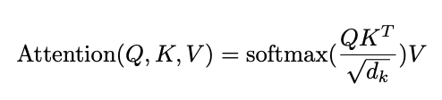
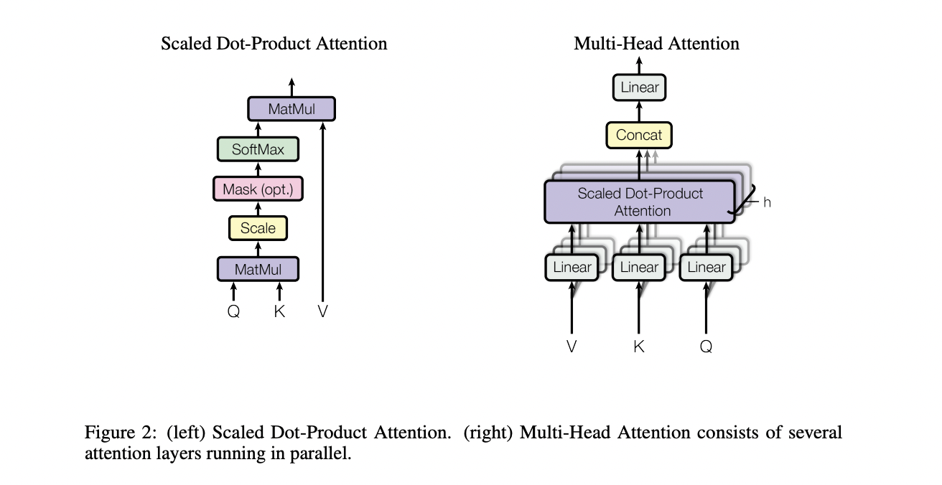
Transformer
[w_{ij}]
←
Why the scaled dot product attention?
Variance increases in high dimensions (summing more terms)
Very large magnitude dot products can cause issues for the softmax
This can lead to small gradients (vanishing gradient)
Normalization via softmax
[s_{ij}]
←
Masking = optional
Scale
1/sqrt(d_{k})
d_{k} = dimensionality, or size of word embedding
←
←
[v₁…v_{n}]
Figure 2. Attention is All You Need
Notes:
For each query-key pair, we're computing their dot product as a similarity measure
The dot product between vectors a and b is calculated as a·b = a^T × b or equivalently a × b^T
Since we're calculating similarities between rows of Q and rows of K, we need to transpose K to align properly
Variance issue with high dimensions: When you compute dot products between vectors with many dimensions, the variance of these products tends to increase with the dimension size. This is because you're summing more terms.
Effect on softmax: Without scaling, in high dimensions, the dot products would have very large magnitudes. When these large values are fed into the softmax function, it would produce extremely peaked distributions - essentially putting nearly all the probability mass on a single value.
Gradient problems: These extremely peaked softmax distributions lead to very small gradients, which causes training to slow down or stall (the vanishing gradient problem).

Slide 30
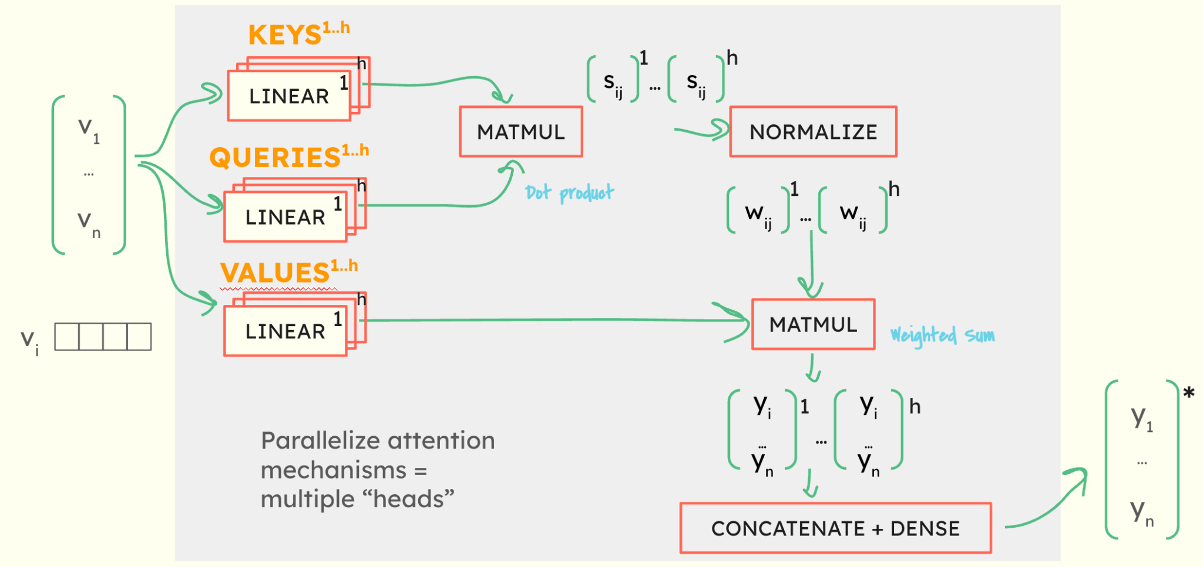
Transformer
=
Figure 2. Attention is All You Need

Slide 31
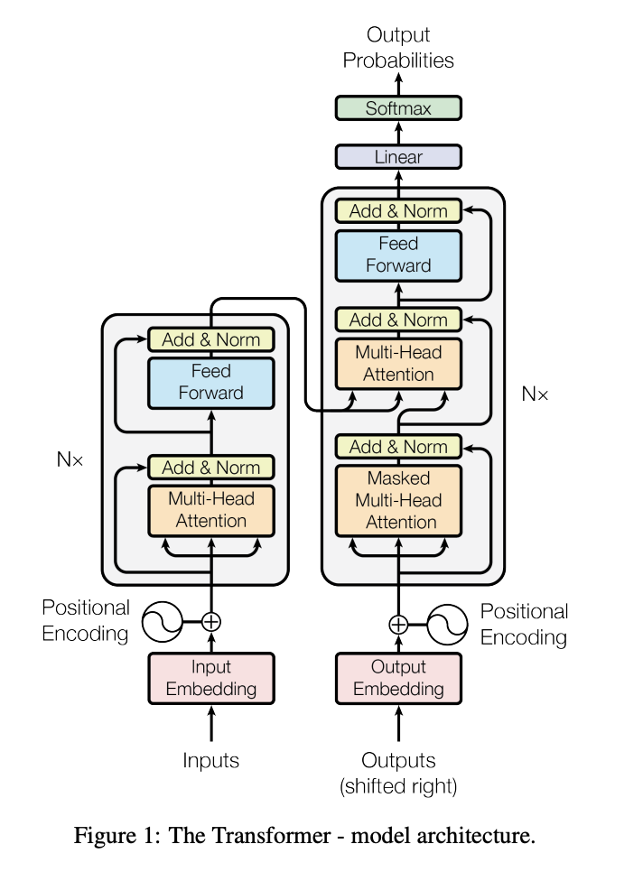
Transformer
Figure 1. Attention is All You Need

Slide 32
32
encoder
decoder
Figure 1. Attention is All You Need

Slide 33
33
encoder
decoder
Figure 1. Attention is All You Need

Slide 34
Transformer Types
Encoder-only | Processes input text through a series of self-attention and feed-forward layers to produce a representation of the input. Do not generate new text from scratch but rather modify or interpret the input text. | - Sentence classification - Named Entity Recognition: identify and classify key info (i.e. names, places) - Text similarity / clustering - Information extraction | BERT (Bidirectional Encoder Representations from Transformers)
Decoder-only | Designed to generate text. Processes input sequence and then generates an output sequence one token at a time, using self-attention mechanisms that allow each output token to depend on previously generated tokens. | -Text generation -Text completion | GPT
Encoder-decoder | Encoder maps an input sequence to an abstract continuous representation that holds all the information of the input. The decoder then takes this representation and generates an output sequence from it. | -Machine translation -Summarization -Q&A -Text-to-Text Tasks (convert one form of text to another, i.e. rewriting sentences in a different style) | -T5 (Text-to-Text Transfer Transformer) -BART (Bidirectional and Auto-Regressive Transformers)

Slide 35
35
Encoder
N_{x} indicates we can stack encoder blocks (hyperparameter)
←
Number of heads (hyperparameter)
←
Figure 1. Attention is All You Need

Slide 36
36
Encoder
Output of multi-head attention combined with original input
←
Figure 1. Attention is All You Need

Slide 37
37
Encoder
Normalized
Output of feed forward block combined with input
←
Normalized
Output of multi-head attention combined with original input
←
Why is this useful?
To minimize vanishing gradients (these are the same skip connections as in Resnet!)
Figure 1. Attention is All You Need

Slide 38
Webcrawl – latest news , maybe use topic modelling to tag documents?
Progress graph
Measure token usage can control i/p o/p
Prompt evaluation
Trick the model, hw does it react?

Slide 39
39
Encoder
v_{i}
Positional Encoding
Remember that attention doesn’t care about position.
But position may be important, so we add it in with this positional encoding
+
p_{i}
v*_{i}
Adds values element-wise to your word embedding that represent the position.
Figure 1. Attention is All You Need
Notes:
Since our model contains no recurrence and no convolution, in order for the model to make use of the order of the sequence, we must inject some information about the relative or absolute position of the tokens in the sequence. To this end, we add "positional encodings" to the input embeddings at the bottoms of the encoder and decoder stacks. The positional encodings have the same dimension dmodel as the embeddings, so that the two can be summed

Slide 40
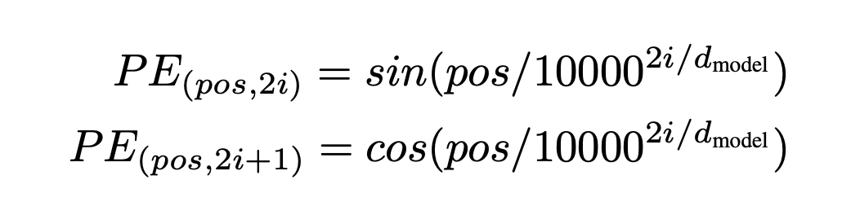
40
Encoder
What is the positional encoding?
This can be defined however you want.
In Attention is All You Need, they tried both
learned positional embeddings and a sinusoidal positional encoding
pos = position in sequence
i = dimension
d_{model} = embedding dimensions (i.e. 512)
Notes:
where pos is the position and i is the dimension. That is, each dimension of the positional encoding corresponds to a sinusoid. The wavelengths form a geometric progression from 2π to 10000 · 2π. We chose this function because we hypothesized it would allow the model to easily learn to attend by relative positions, since for any fixed offset k, P Epos+k can be represented as a linear function of P Epos. We also experimented with using learned positional embeddings [9] instead, and found that the two versions produced nearly identical results (see Table 3 row (E)). We chose the sinusoidal version because it may allow the model to extrapolate to sequence lengths longer than the ones encountered during training.

Slide 41
Word with highest probability selected as most likely word
41
Decoder
Softmax converts logits to probability scores for each word
Decoder output mapped to logits for each word in the trained vocabulary by a linear layer
←
Masking prevents tokens from attending to future tokens in the sequence
How it works: A very large negative value (like -inf) is added to the scores at positions that should be masked, which results in near-zero probabilities after the softmax.
Previous timestep outputs used as inputs
←
Figure 1. Attention is All You Need

Slide 42
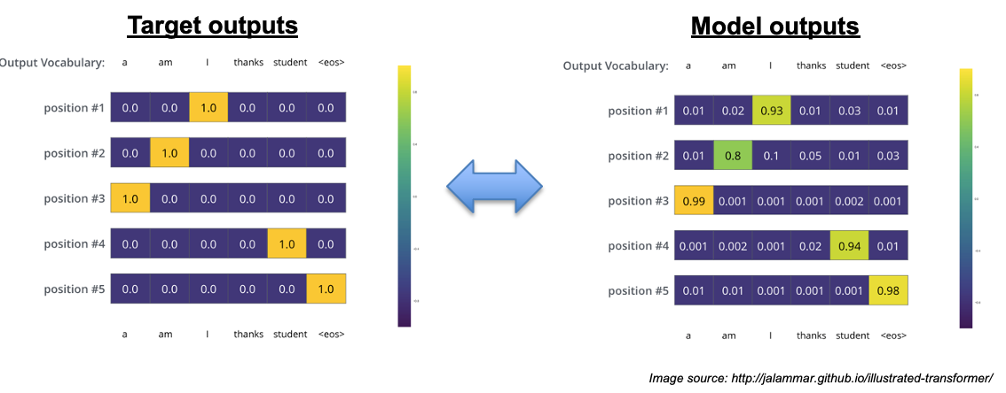
42
Decoder
Evaluating Decoder Output:
We get the probabilistic prediction of each word at each position
We can compare this to the actual words at each position and use cross-entropy loss to train the model

Slide 43
43
Encoder-Decoder
Encoder compresses input into contextualized representations before passing to decoder, creating an information bottleneck that helps focus on relevant information
Cross-Attention Mechanism: Decoders attend to encoder outputs, creating direct information pathways between input and output

Slide 44
Encoder:
Processes entire input at once
Uses bidirectional self-attention
Produces contextual representations
Decoder:
Generates output token by token
Uses masked self-attention
Uses cross-attention to encoder (in encoder-decoder models)

Slide 45
Required Reading:
The Annotated Transformer
https://nlp.seas.harvard.edu/annotated-transformer/
Recommended Reading:
Transformers from Scratch
https://e2eml.school/transformers.html
Transformers explained visually
https://www.youtube.com/watch?v=wjZofJX0v4M
Build GPT from scratch (Andrej Karpathy)
https://www.youtube.com/watch?v=kCc8FmEb1nY

Slide 46
46
At Inference
Input data tokenized
Token → embedding
Positional encodings added to embeddings
Notes:
Input data is tokenized
Each token is converted into an embedding
Positional encodings added to the embeddings (giving the model information about the position of each token in a sequence)
Encoder layers
Self-attention Mechanism - weigh the importance of other tokens when processing a specific token in the input sequence, helping the model to understand the context around each token
FF NN
Decoder layers
Further passed through multiple decoder layers to generate output. Each decoder layer has a self-attention mechanism, but it is masked to prevent tokens from attending to future tokens in the sequence.
In encoder-decoder models, the decoder also has cross-attention layers that allow it to attend to the output of the encoder layers.
Output generation
Final decoder layer's output is passed to a linear layer and then through a softmax function to generate probabilities for each token in the model's vocabulary
The token with the highest probability is often selected as the output at each step
Post-processing
The generated sequence of tokens is then converted back into the desired format, such as a string of text

Slide 47
47
At Inference
Encoder Layers
Self attention weighs importance of other tokens when processing specific token in input sequence
FF NN
Decode Layers
Each decoder layer has a self attention mechanism, but it is masked to prevent tokens from attending to future tokens in sequence
In encoder-decoder models, the decoder also has cross-attention layers that allow it to attend to the output of the encoder layers
Output Generation
Final decoder layer’s output passed to linear layer + softmax function to generate probabilities for each token in the model’s vocabulary
Token with highest probability is often selected as the output at each step
Notes:
Input data is tokenized
Each token is converted into an embedding
Positional encodings added to the embeddings (giving the model information about the position of each token in a sequence)
Encoder layers
Self-attention Mechanism - weigh the importance of other tokens when processing a specific token in the input sequence, helping the model to understand the context around each token
FF NN
Decoder layers
Further passed through multiple decoder layers to generate output. Each decoder layer has a self-attention mechanism, but it is masked to prevent tokens from attending to future tokens in the sequence.
In encoder-decoder models, the decoder also has cross-attention layers that allow it to attend to the output of the encoder layers.
Output generation
Final decoder layer's output is passed to a linear layer and then through a softmax function to generate probabilities for each token in the model's vocabulary
The token with the highest probability is often selected as the output at each step
Post-processing
The generated sequence of tokens is then converted back into the desired format, such as a string of text

Slide 48
48
At Inference
Generated sequence of tokens then converted back into desired format (ie string of text)
Notes:
Input data is tokenized
Each token is converted into an embedding
Positional encodings added to the embeddings (giving the model information about the position of each token in a sequence)
Encoder layers
Self-attention Mechanism - weigh the importance of other tokens when processing a specific token in the input sequence, helping the model to understand the context around each token
FF NN
Decoder layers
Further passed through multiple decoder layers to generate output. Each decoder layer has a self-attention mechanism, but it is masked to prevent tokens from attending to future tokens in the sequence.
In encoder-decoder models, the decoder also has cross-attention layers that allow it to attend to the output of the encoder layers.
Output generation
Final decoder layer's output is passed to a linear layer and then through a softmax function to generate probabilities for each token in the model's vocabulary
The token with the highest probability is often selected as the output at each step
Post-processing
The generated sequence of tokens is then converted back into the desired format, such as a string of text

Slide 49
49
At Inference
🍊 🟧
Different Embeddings for Different Meanings
In the context of "I ate an orange," the embedding for "orange" would be closer to embeddings for other fruits or food-related contexts 🍊🍎🫐
In the context of "The sunset is orange," the embedding for "orange" would be closer to color-related terms or descriptions of nature 🟧 🌅 🌈
Inference
At inference time, when a model encounters the word "orange," it doesn't rely on a predetermined static vector.
Rather, it dynamically generates an embedding for "orange" by considering the entire sentence or surrounding text.
Attention allows it to weigh the relevance of each surrounding word to determine the most appropriate meaning of "orange" in that specific context.

Slide 50
50
Token Limits
Theoretically there is not a token limit.
The complexity of calculating attention scores is quadratic (O(n²)) with respect to the sequence of length n.
Computation & Memory
Gradients calculated over long sequences may become less meaningful
Training is less efficient on long sequences
Batch size and sequence length directly affect memory required during training (to maintain manageable memory, there is a tradeoff between batch size and max token limit)
Optimizations to increase token limits:
Sparse attention patterns (i.e. Longformer, BigBird)
Techniques like gradient checkpointing and mixed-precision training to manage memory more efficiently
Parallel processing (specialized GPUs)

Slide 51
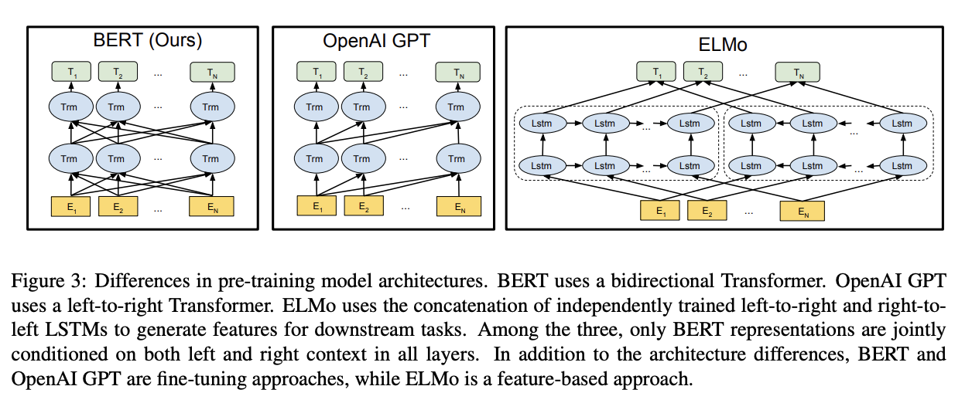
51
BERT, ELMo, and GPT
Encoder-only
Decoder-only
Notes:
Left panel (BERT): Shows a bidirectional Transformer architecture. The yellow boxes at the bottom (E₁, E₂, ..., Eₙ) represent token embeddings. These feed into transformer layers (Trm) with connections going in multiple directions, allowing each token to attend to all other tokens in both directions. This bidirectional nature is BERT's key feature, allowing it to condition each token representation on both left and right context at all layers.
Middle panel (OpenAI GPT): Shows a left-to-right Transformer architecture. It also starts with token embeddings at the bottom, but the transformer layers are connected in a way that each position can only attend to previous positions, not future ones. This creates a unidirectional (left-to-right) flow of information.
Right panel (ELMo): Shows a more complex structure using LSTMs (Long Short-Term Memory networks). It has token embeddings at the bottom, but instead of transformers, it uses two separate LSTM chains - one processing text left-to-right and another right-to-left. These independent directional representations are then concatenated to generate features for downstream tasks.
The caption highlights that only BERT conditions its representations on both left and right context in all layers. It also notes that BERT and GPT are fine-tuning approaches (meaning the entire pre-trained model is updated during task-specific training), while ELMo is a feature-based approach (where the pre-trained representations are used as input features for task-specific architectures without modifying the original model).

Slide 52
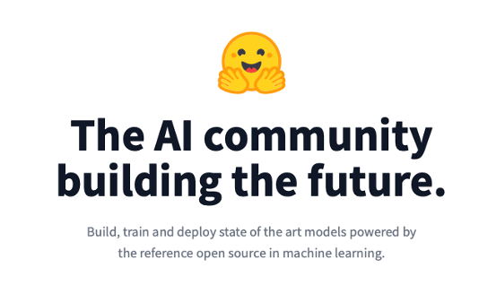
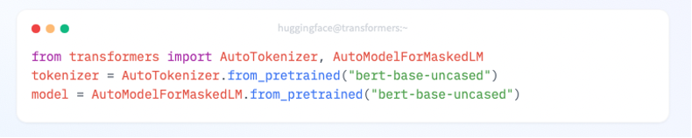
52
Hugging Face Transformers 🤗
The transformers library has 3 building blocks:
A tokenizer
A transformer architecture
A head for NLP tasks
e.g Text Classification, Generation, Sentiment Analysis, Translation, Summarization

Slide 53
Applied NLP
Text Similarity
Text Summarization
Topic Modeling

Slide 54


Measures how similar two documents are
54
Text Similarity
Lexical Similarity:
Similar vocabulary
Semantic Similarity:
Similar meaning

Slide 55
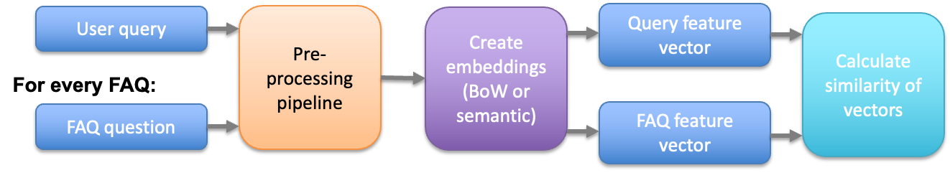
Measures how similar two documents are
55
Text Similarity
How?
Calculate similarity between embeddings

Slide 56
56
Text Summarization
Extractive summarization
Select a subset of sentences from the original text that attempt to retain the most important points of the document
All elements come from original document
Abstractive summarization
Attempts to understand original document and then attempt to generate a shorter document which retains the key points of the original
May use different language than original document

Slide 57

57
Text Summarization
Web page summaries
Email summaries
Scientific article summaries
Video transcription summaries

Slide 58
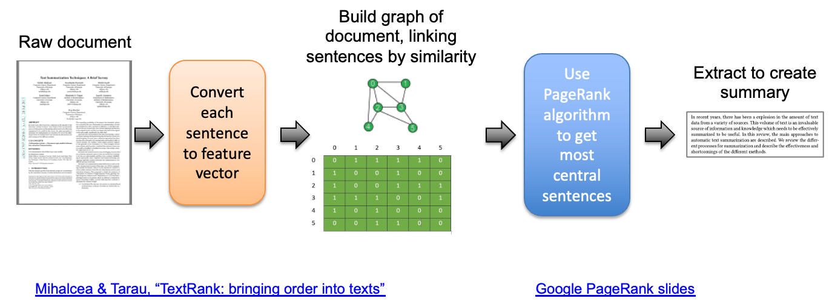
58
Text Summarization
Extractive Example
TextRank uses an unsupervised graph-based approach to identifying and extracting the most “central” sentences in a document

Slide 59
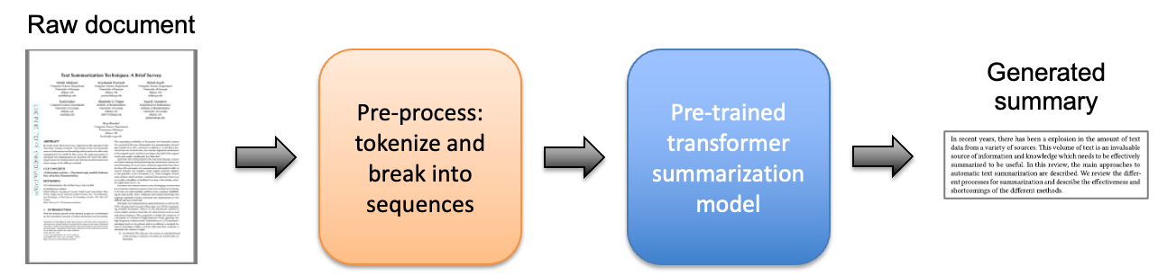
59
Text Summarization
Abstractive Example
We can use transformer models pre-trained on a summarization dataset or train them ourselves
Note that larger documents must be broken into sequences with a max length dictated by the model architecture

Slide 60
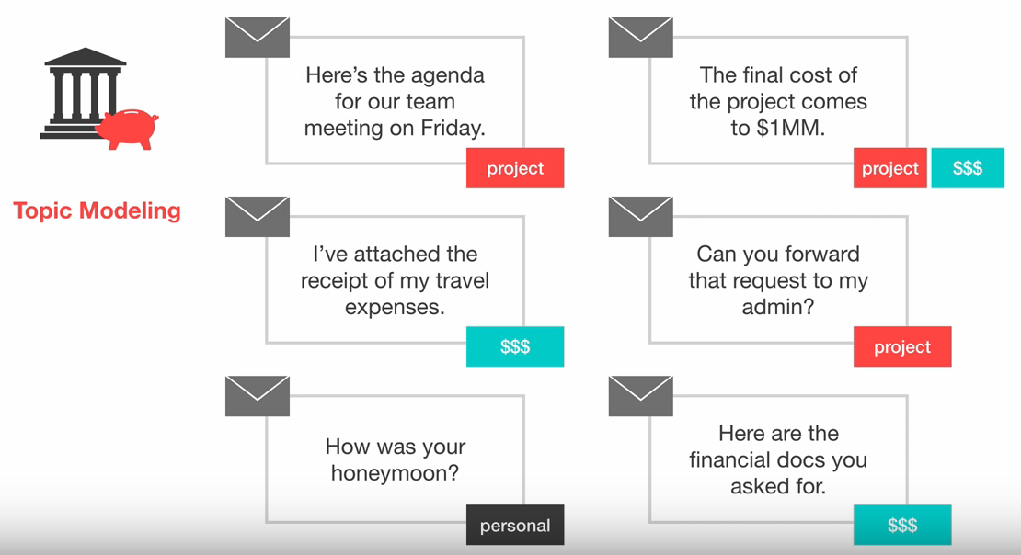
60
Topic Modeling
Can be useful to “tag” documents based on topics or attributes
Applications:
Auto-tagging of web articles
Unsupervised document classification
Identifying attributes in product reviews
Auto-tagging customer support tickets

Slide 61
61
Topic Modeling
Methods
Supervised - if sufficient labeled training data is available
Unsupervised -
[Traditional] Latent Semantic Analysis (LSA)
[Traditional] Latent Dirichlet Allocation (LDA)
Transformer embeddings

Slide 62
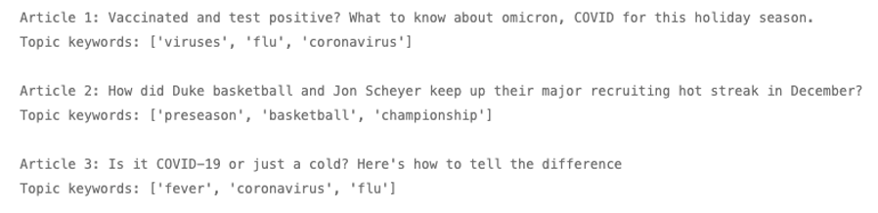
62
Topic Modeling
Could assume the topic’s keywords are contained in the document
Which words are the right keywords?
Compare the encoding of each word in the document to the overall document encoding
Words with closest embedding to document (based on cosine similarity) are probably the keywords

Slide 63
Advanced Topics
Visualizing Embedding Spaces
LLMs
Beyond language (multimodality)

Slide 64
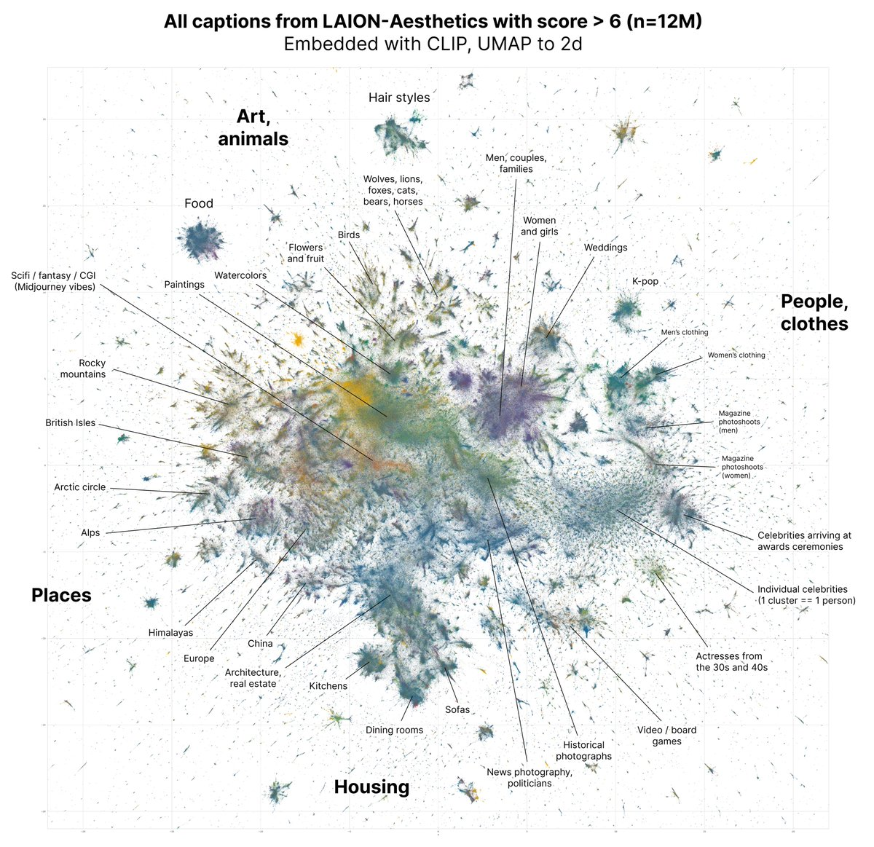
512 dimensions
Plot in 2 dimensions
Image Source: David McClure Twitter
Notes:
Clip-vit-base-patch32
https://huggingface.co/datasets/dclure/laion-aesthetics-12m-umap?row=0

Slide 65
🍦
🍲
🍲
🍦
Food Not Food
🍦
🍲
Cold Hot
🍲
🍦
Bitter Spicy Salty Umami Sour Sweet
🍲
🍦
Served in bowl/cone Served on its own
🍲
🍦
Contains vegetables Shouldn’t
Notes:
Clip-vit-base-patch32
https://huggingface.co/datasets/dclure/laion-aesthetics-12m-umap?row=0

Slide 66
🍦
🍲
🧁
🍪
🍊
🧢
🍓
🍦
🍎
👗
🍧
Compressed dimension 1
🍅
🍝
🍜
🍲
🥕
🥦
🧅
Compressed dimension 2
Notes:
Clip-vit-base-patch32
https://huggingface.co/datasets/dclure/laion-aesthetics-12m-umap?row=0

Slide 67
Dimensionality Reduction
PCA
Focus is on capturing global linear relationships in the data
Use to: simplify and find global linear relationships and patterns in the data
t-SNE
Constructs a lower-dimensional representation where similar data points are placed closer together
Use to: Emphasize visualization, reveal local patterns and clusters
UMAP
Uses manifold learning (nonlinear dimensionality reduction) to understand the underlying structure or shape of the data
Focus on capturing complex, non-linear relationships in the data
Use to: preserve local structure and handle complex, nonlinear relationships
Deep Dive into How they Work
Notes:
Clip-vit-base-patch32
https://huggingface.co/datasets/dclure/laion-aesthetics-12m-umap?row=0

Slide 68
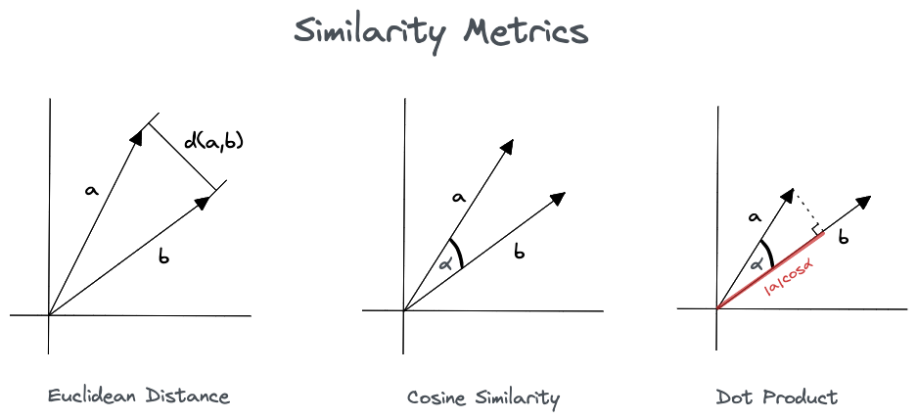
Similarity in Semantic Space
Cosine similarity
Euclidean distance
Dot product
Manhattan Distance
Mahalanobis Distance
Jaccard Similarity
Many, many others!
Image from Pinecone
Notes:
Clip-vit-base-patch32
https://huggingface.co/datasets/dclure/laion-aesthetics-12m-umap?row=0

Slide 69
Similarity in Semantic Space
Cosine similarity
Measures the angle between vectors
Normalizes the dot product by the size of the vectors
Invariant to vector magnitude
Range: [-1, 1] (higher=more similar)
Formula: cos(θ) = A·B / (||A||·||B||)
Image from Pinecone
Notes:
Magnitude insensitivity: While often an advantage, it can be a limitation when vector magnitude contains important information. Two vectors pointing in the same direction will have a similarity of 1 regardless of huge differences in magnitude.
No concept of proximity: It only measures directional similarity, not how "close" vectors are in the embedding space. Two vectors on opposite sides of the space can have high similarity if they point in similar directions.
Limited for asymmetric relationships: Cosine similarity is symmetric (sim(A,B) = sim(B,A)), making it inadequate for relationships where direction matters.
Sensitivity to small angles: It's very sensitive to small angle differences when vectors are nearly aligned, but less discriminative for larger angles.
Assumes linear relationships: It doesn't capture non-linear relationships between features.
Struggles with sparse vectors: In high-dimensional, sparse spaces (like text), many vectors may have similarity scores close to zero, reducing discriminative power.
Curse of dimensionality: In very high dimensions, cosine similarity (like many distance metrics) can become less meaningful as vectors tend to become equidistant from each other.
Domain dependence: The interpretation of what constitutes a "good" cosine similarity score varies significantly across different domains and applications.

Slide 70
Similarity in Semantic Space
Cosine similarity
Measures the angle between vectors
Normalizes the dot product by the size of the vectors
Invariant to vector magnitude
Range: [-1, 1] (higher=more similar)
Formula: cos(θ) = A·B / (||A||·||B||)
Not perfect: - No concept of proximity (Two vectors on opposite sides of the space can have high similarity if they point in similar directions.)
- Assumes linear relationships
- Struggles with sparse vectors
- How to define a “good” cosine similarity?
Image from Pinecone
Notes:
Magnitude insensitivity: While often an advantage, it can be a limitation when vector magnitude contains important information. Two vectors pointing in the same direction will have a similarity of 1 regardless of huge differences in magnitude.
No concept of proximity: It only measures directional similarity, not how "close" vectors are in the embedding space. Two vectors on opposite sides of the space can have high similarity if they point in similar directions.
Limited for asymmetric relationships: Cosine similarity is symmetric (sim(A,B) = sim(B,A)), making it inadequate for relationships where direction matters.
Sensitivity to small angles: It's very sensitive to small angle differences when vectors are nearly aligned, but less discriminative for larger angles.
Assumes linear relationships: It doesn't capture non-linear relationships between features.
Struggles with sparse vectors: In high-dimensional, sparse spaces (like text), many vectors may have similarity scores close to zero, reducing discriminative power.
Curse of dimensionality: In very high dimensions, cosine similarity (like many distance metrics) can become less meaningful as vectors tend to become equidistant from each other.
Domain dependence: The interpretation of what constitutes a "good" cosine similarity score varies significantly across different domains and applications.

Slide 71
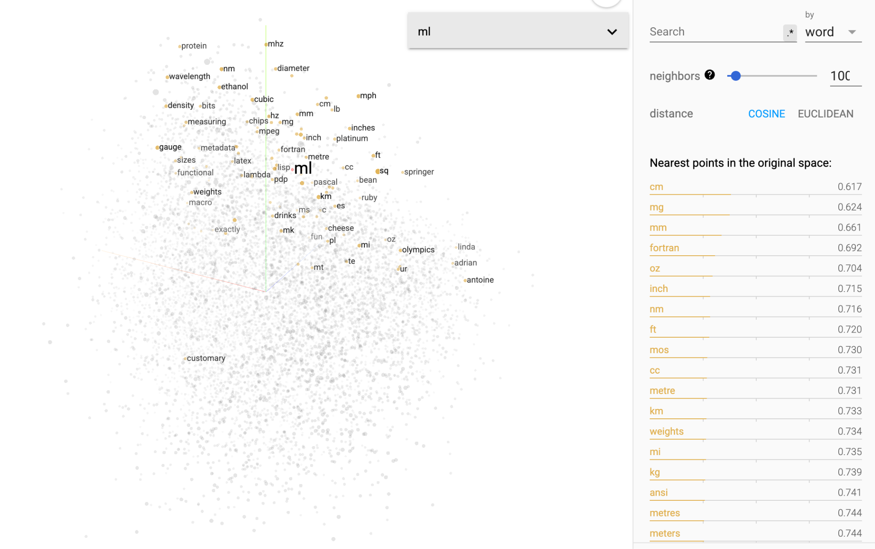

71
https://projector.tensorflow.org/

Slide 72
LLMs
What is a large language model?

Slide 73
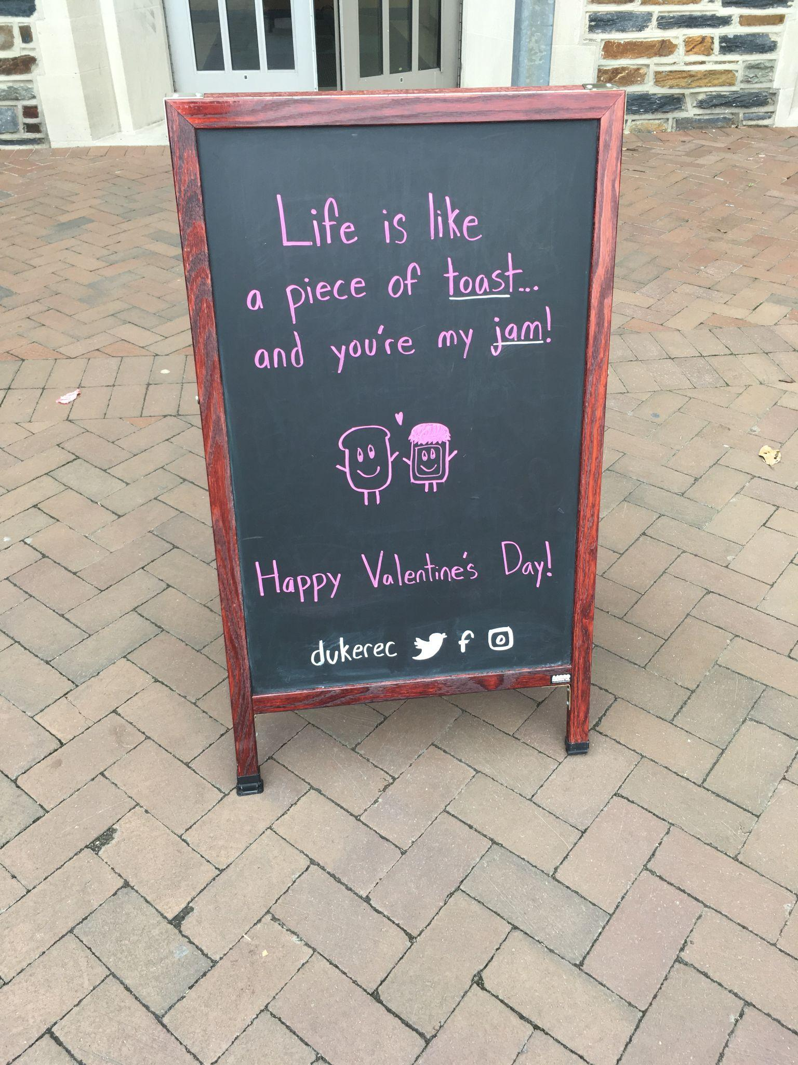
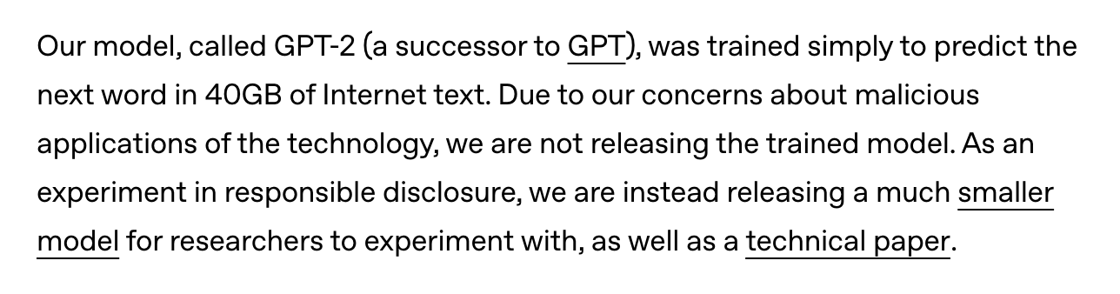
LLMs
The definition is evolving!
GPT-1 of 2018 is usually considered the first LLM, even though it has only 117 million parameters.
Open AI press release on GPT-2 (Feb 14, 2019)
Notes:
https://informationisbeautiful.net/visualizations/the-rise-of-generative-ai-large-language-models-llms-like-chatgpt/

Slide 74
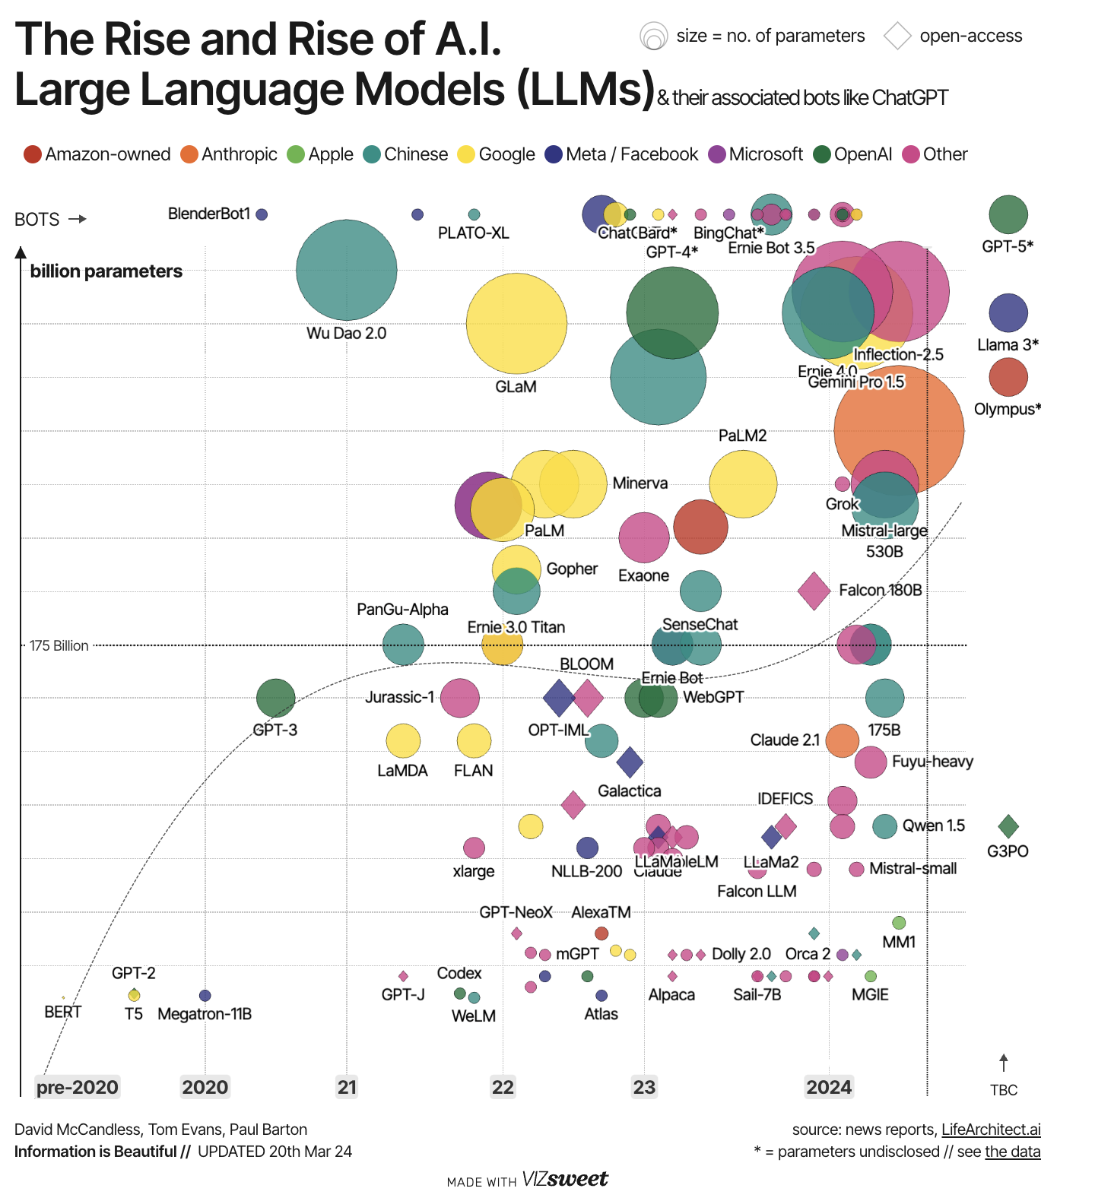
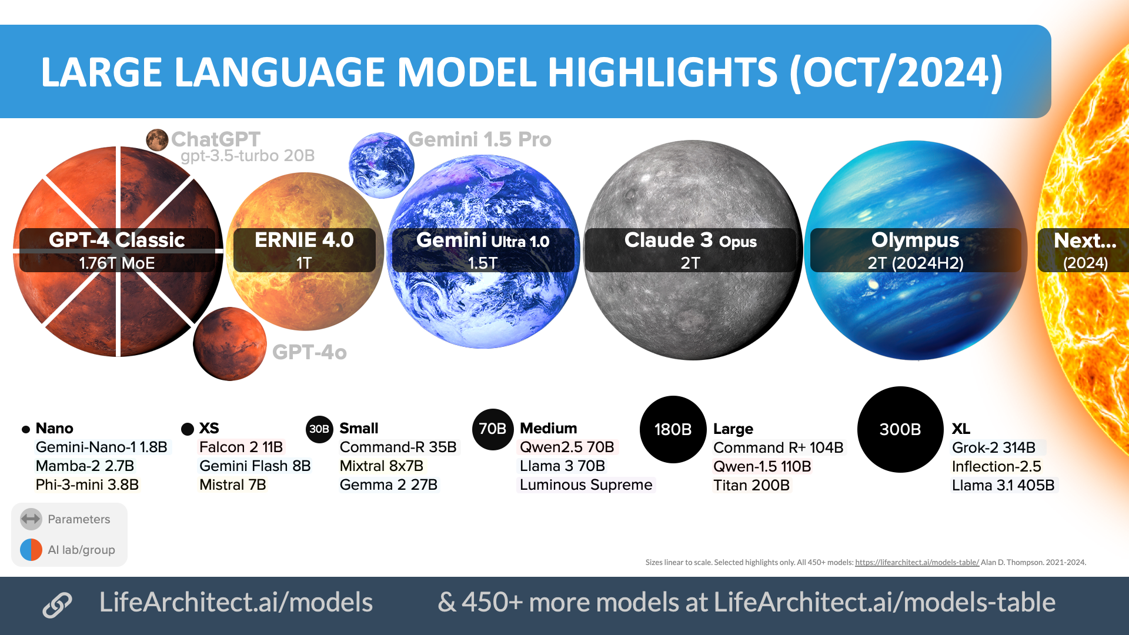
LLMs
The definition is evolving!
Notes:
https://informationisbeautiful.net/visualizations/the-rise-of-generative-ai-large-language-models-llms-like-chatgpt/

Slide 75
Small LMs
The definition is also evolving!
Currently “small” language models are a few million to a few billion parameters in size.

Slide 76
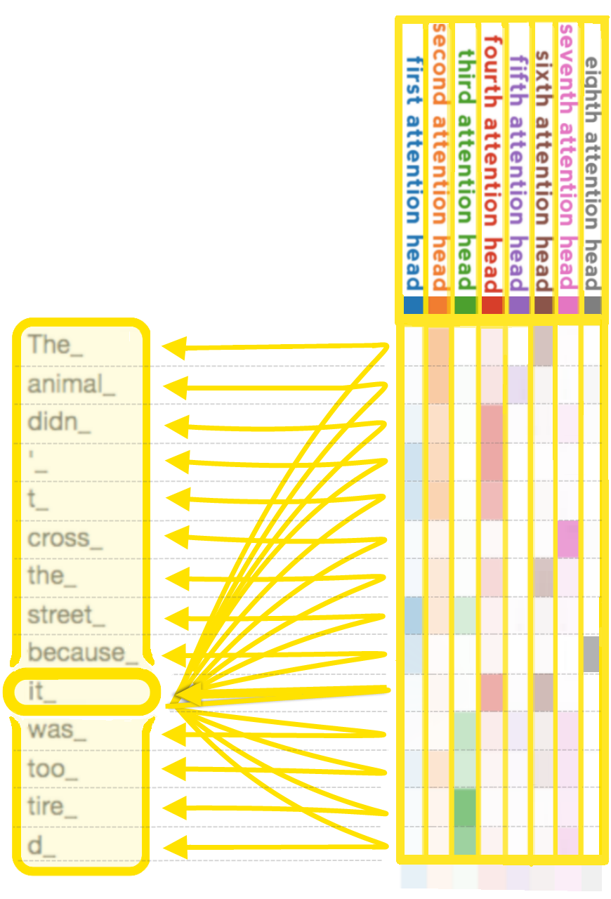
What you can do with LMs
Well, anything you want!
Rely on those fundamentals and don’t get caught up in the “magic”
Fine-tuning/Transfer Learning Small LMs - often more effective than using an LLM
Prompt Engineering

Slide 77
What you can do with LMs
Prompt Engineering
Retrieval Augmented Generation (RAG)
Agent-ish architectures
The path to an “easy” NLP project?
Or a huge can of worms?

Slide 78
Vector
Database
Vector | Unstructured Data
23594985038034960 | SKU, description, image
48588569834098384 | SKU, description, image
58489543034903200 | SKU, description, image
45968945860483094 | SKU, description, image
Retrieval Augmented Generation with an LLM in the Loop
Embedding Model transforms user query into vector embeddings
Similarity Algorithm to find closest match between items in database and user query
User 🧑‍💻
User Query
？
4573030205038034960 | “Black leather boots”
The closest match(es) are fed as part of the prompt to a large language model (LLM)
The LLM generates a response to the user’s query and this response is sent back to the user

Slide 79
Considerations: Chunking for vDB
How do you want to split your data to be fed into the embedding model? Each chunk will correspond to a vector. You get to choose this split.
By sentence? By paragraph? By section? By document?
How to choose?
Based on your application!
What level of information do you need to access? (ie Q&A app, product search)
You will probably need to run experiments to determine best strategy (how to evaluate?)
Unstructured Data
🏞📝▶️
Chunk Data
Embedding Model transforms data into vector embeddings
Vector
Database
Vector | Unstructured Data
23594985038034960 | SKU, description, image
48588569834098384 | SKU, description, image
58489543034903200 | SKU, description, image
45968945860483094 | SKU, description, image

Slide 80
Considerations: Choosing embedding model
Which one to use?
Consider:
Accuracy for your application (ie text classification) - HF MTEB leaderboard
Open source vs. paid (also commercial vs. non-commercial license if developing a product)
Difficulty in hosting
How easy it is to implement in existing tools
How to evaluate?
Unstructured Data
🏞📝▶️
Chunk Data
Embedding Model transforms data into vector embeddings
Vector
Database
Vector | Unstructured Data
23594985038034960 | SKU, description, image
48588569834098384 | SKU, description, image
58489543034903200 | SKU, description, image
45968945860483094 | SKU, description, image

Slide 81
Considerations: Which similarity method?
How to choose similarity method?
“Because everyone else uses cosine similarity” is not valid rationale. Why is cosine similarity (or other approach) the best for YOUR use case?
How will you evaluate which is best?
Vector
Database
Vector | Unstructured Data
23594985038034960 | SKU, description, image
48588569834098384 | SKU, description, image
58489543034903200 | SKU, description, image
45968945860483094 | SKU, description, image
Similarity Algorithm to find closest match between items in database and user query
4573030205038034960 | “Black leather boots”

Slide 82
Considerations: Choosing an LLM
Which one to use?
Consider:
Accuracy for your application
Cost
Size
Deployment (i.e. via API or do you need to run it on prem and/or on edge?)
Have you evaluated the rest of your pipeline using your target LLM?
Similarity Algorithm to find closest match between items in database and user query
User 🧑‍💻
The closest match(es) are fed as part of the prompt to a large language model (LLM)
The LLM generates a response to the user’s query and this response is sent back to the user

Slide 83
The Curse of Evaluation
LLM
Similarity Metric
Embedding Model
Chunking Method
Evaluation Approach

Slide 84



The Curse of Evaluation
How to evaluate??
Hold similarity metric constant
Hold embedding model constant
Hold LLM constant
Hold architecture constant
Hold prompting constant
Run through different chunking approaches across the different documents.
Get output of pipeline.
Could also look at subset of pipeline, i.e. just the retrieval component (minus generation via LLM)
How to know if output is correct?
There is no best practice for this yet.
Decide on Chunking Approach:
Sentence
Paragraph
Section
Document
Custom manual sections
Different documents may require different approaches

Slide 85
The Curse of Evaluation
Now we want to evaluate the embedding model.
We decide that we want to use a different embedding model than the one we used previously to determine the best chunking approach.
Do we need to run that experiment again?

Slide 86
The Curse of Evaluation
LLM
Similarity Metric
Embedding Model
Chunking Method
Evaluation Approach

Slide 87
The Curse of Evaluation
Options for evaluation -
(All come with their own pros/cons)
User judgement (A/B testing, user research metrics)
LLM-as-a-judge (better: a different LLM as a judge or multiple LLM judges)
Text similarity metrics (similarity in embedding space) between “desired output” and actual output (what is desired output?? Usually need to have a dataset or create your own)
Basic metrics (latency/cost of inference)

Slide 88
Before you build it…
Answer the questions:
How will you evaluate it?
What will you need to evaluate it?

Slide 89
Beyond language…

Slide 90
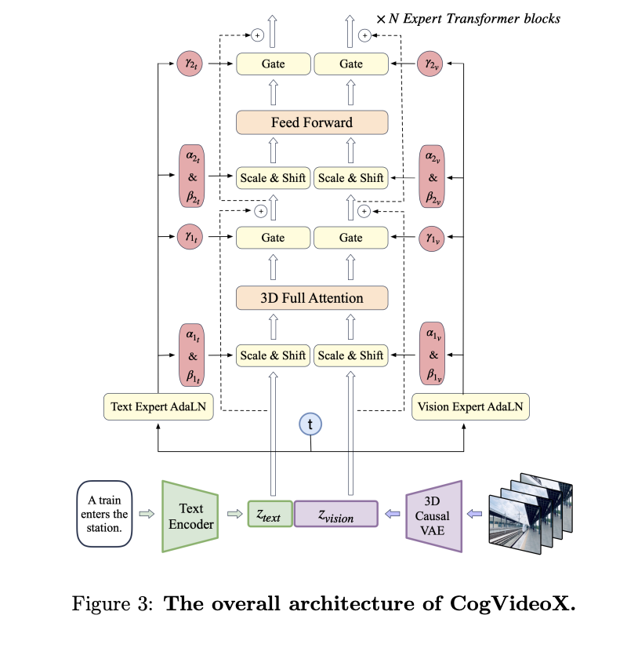
Anything you can tokenize, you can use a transformer for!
Images → CLIP, BLIP-2
Spectograms (speech/audio) → AST
Time Series → Timer, Informer (Autoformer)
Video → CogVideoX
Notes:
Clip-vit-base-patch32
https://huggingface.co/datasets/dclure/laion-aesthetics-12m-umap?row=0

Slide 91
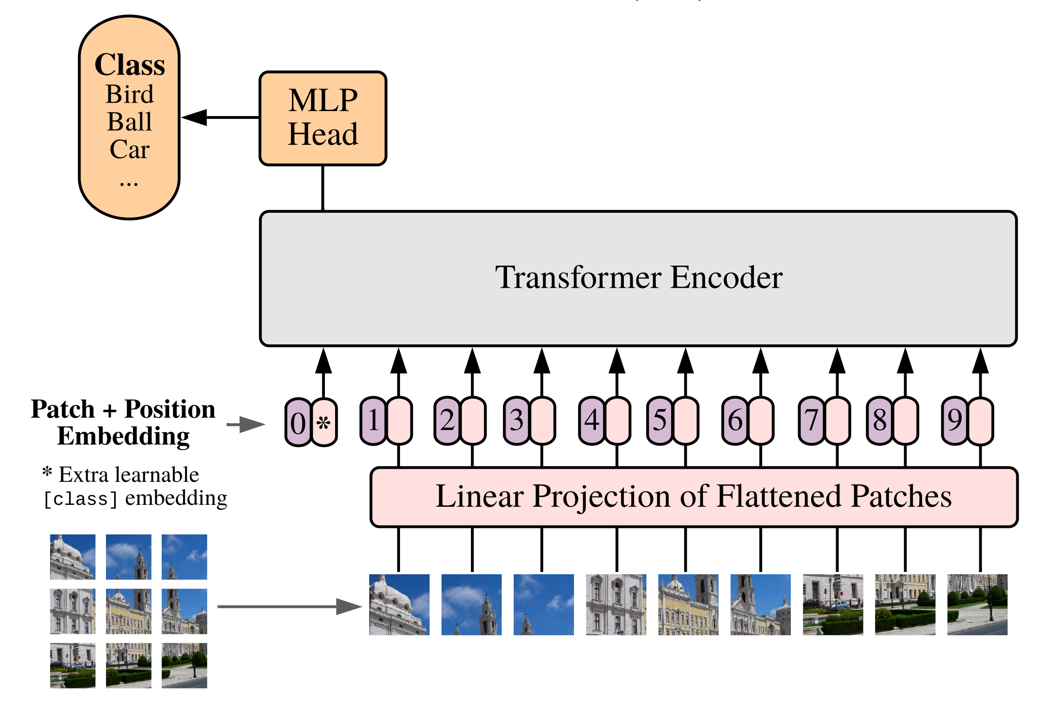
ViT (2020)
Up until this paper, research attempted to introduce self-attention at the pixel level
224x224px → 50k sequence length!
"tokenize" the image by chopping it into patches of 16x16px, and treating each patch as a token, embedding it into input space
An Image is Worth 16x16 Words: Transformers for Image Recognition at Scale (Paper 2020)

Slide 92
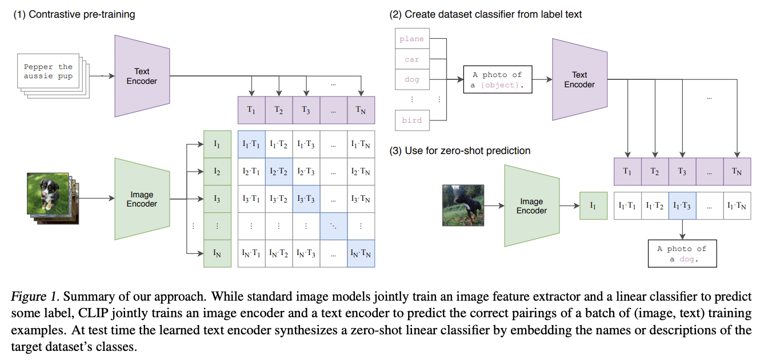
CLIP (2021)
Notes:
Here's what's happening step by step:
Input Processing:
I[n, h, w, c]: A batch of n images with height h, width w, and c channels
T[n, l]: A batch of n text sequences, each with length l
W_i and W_t: Learned projection matrices for image and text
t: A learned temperature parameter to scale the similarity scores
Feature Extraction:
I_f = image_encoder(I): Images are encoded using a vision model (ResNet or Vision Transformer) into feature vectors of dimension d_i
T_f = text_encoder(T): Text is encoded using a text model (CBOW or Text Transformer) into feature vectors of dimension d_t
Embedding Projection and Normalization:
I_e = l2_normalize(np.dot(I_f, W_i), axis=1): Project image features to a common embedding space and normalize
T_e = l2_normalize(np.dot(T_f, W_t), axis=1): Project text features to the same embedding space and normalize
Similarity Calculation:
logits = np.dot(I_e, T_e.T) * np.exp(t): Calculate pairwise cosine similarities between all image-text pairs in the batch, scaled by the temperature parameter
Loss Computation:
labels = np.arange(n): Create diagonal labels (each image matches with its corresponding text)
loss_i: Cross-entropy loss treating rows as predictions (image-to-text direction)
loss_t: Cross-entropy loss treating columns as predictions (text-to-image direction)
loss = (loss_i + loss_t)/2: The final loss is the average of both directional losses
The key insight is that CLIP trains on image-text pairs and learns to maximize the similarity between matching pairs while minimizing similarity between non-matching pairs. This creates a joint embedding space where related images and texts are positioned close together, enabling zero-shot classification and cross-modal retrieval.

Slide 93
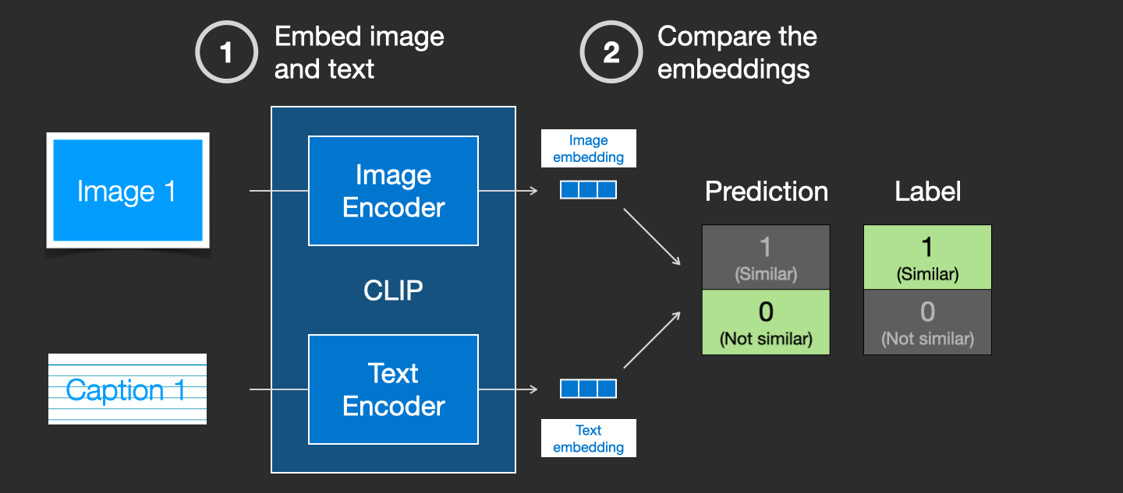
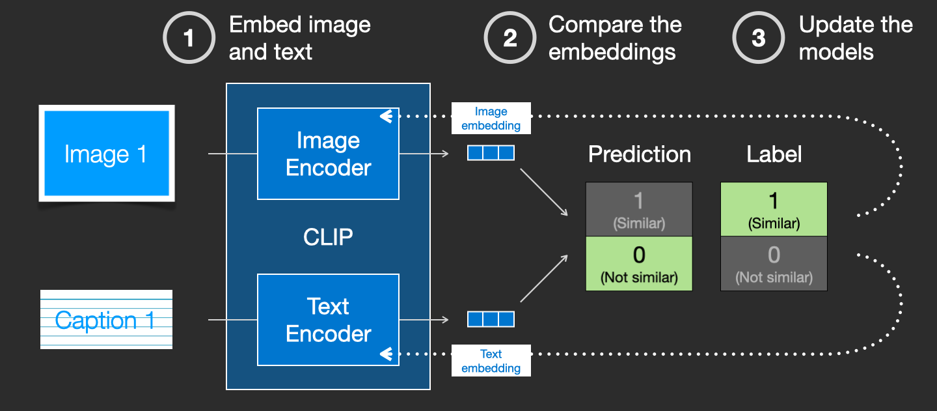
Text Encoder: CLIP
93
Image Source
Notes:
Next, let’s look at the conditioning element encoder.
It Encodes the user prompt into latent space.
In text2image generation, this is a text encoder
In image2image generation, this is an image encoder
The user prompt is used to inform each step of the denoising U-Net, guiding the U-Net to give a certain output

Slide 94
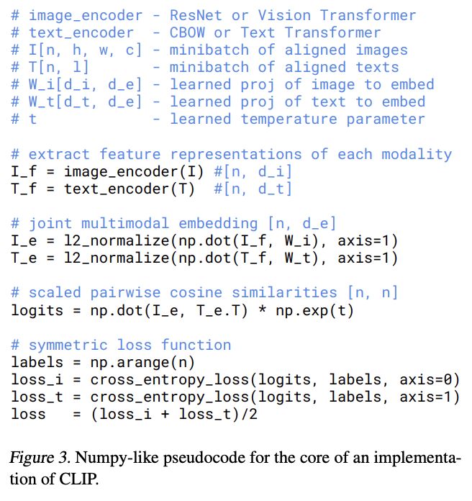
I[n, h, w, c]: A batch of n images with height h, width w, and c channels
T[n, l]: A batch of n text sequences, each with length l
t: A learned temperature parameter to scale the similarity scores
I_f = image_encoder(I): Images are encoded using a vision model (ResNet or Vision Transformer) into feature vectors of dimension d_i
T_f = text_encoder(T): Text is encoded using a text model (CBOW or Text Transformer) into feature vectors of dimension d_t
I_e = l2_normalize(np.dot(I_f, W_i), axis=1): Project image features to a common embedding space and normalize
T_e = l2_normalize(np.dot(T_f, W_t), axis=1): Project text features to the same embedding space and normalize
logits = np.dot(I_e, T_e.T) * np.exp(t): Calculate pairwise cosine similarities between all image-text pairs in the batch, scaled by the temperature parameter
labels = np.arange(n): Create diagonal labels (each image matches with its corresponding text)
loss_i: Cross-entropy loss treating rows as predictions (image-to-text direction)
loss_t: Cross-entropy loss treating columns as predictions (text-to-image direction)
loss = (loss_i + loss_t)/2: The final loss is the average of both directional losses
CLIP (2021)
Notes:
Input Processing:
I[n, h, w, c]: A batch of n images with height h, width w, and c channels
T[n, l]: A batch of n text sequences, each with length l
W_i and W_t: Learned projection matrices for image and text
t: A learned temperature parameter to scale the similarity scores
Feature Extraction:
I_f = image_encoder(I): Images are encoded using a vision model (ResNet or Vision Transformer) into feature vectors of dimension d_i
T_f = text_encoder(T): Text is encoded using a text model (CBOW or Text Transformer) into feature vectors of dimension d_t
Embedding Projection and Normalization:
I_e = l2_normalize(np.dot(I_f, W_i), axis=1): Project image features to a common embedding space and normalize
T_e = l2_normalize(np.dot(T_f, W_t), axis=1): Project text features to the same embedding space and normalize
Similarity Calculation:
logits = np.dot(I_e, T_e.T) * np.exp(t): Calculate pairwise cosine similarities between all image-text pairs in the batch, scaled by the temperature parameter
Loss Computation:
labels = np.arange(n): Create diagonal labels (each image matches with its corresponding text)
loss_i: Cross-entropy loss treating rows as predictions (image-to-text direction)
loss_t: Cross-entropy loss treating columns as predictions (text-to-image direction)
loss = (loss_i + loss_t)/2: The final loss is the average of both directional losses
CLIP trains on image-text pairs and learns to maximize the similarity between matching pairs while minimizing similarity between non-matching pairs. This creates a joint embedding space where related images and texts are positioned close together, enabling zero-shot classification and cross-modal retrieval.

Slide 95
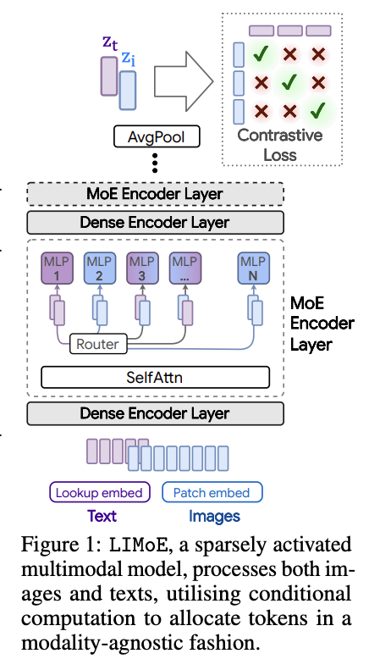

Mixture of Experts
In traditional transformers, all parameters are used for every input, but MoE models only activate a small subset of parameters (the "experts") for each input token
Instead of the dense FFN, MoE layers have a certain number of “Experts” where each expert is a NN (any NN!)
There is also a router network, composed of learned parameters and trained at the same time as the network
GIF source
Recommended Reading
Notes:
https://docs.google.com/presentation/d/1ZXFIhYczos679r70Yu8vV9uO6B1J0ztzeDxbnBxD1S0/edit#slide=id.g13dd67c5ab8_0_3897
Sparse MoE layers are used instead of dense feed-forward network (FFN) layers. MoE layers have a certain number of “experts” (e.g. 8), where each expert is a neural network. In practice, the experts are FFNs, but they can also be more complex networks or even a MoE itself, leading to hierarchical MoEs!
A gate network or router, that determines which tokens are sent to which expert. For example, in the image below, the token “More” is sent to the second expert, and the token "Parameters” is sent to the first network. As we’ll explore later, we can send a token to more than one expert. How to route a token to an expert is one of the big decisions when working with MoEs - the router is composed of learned parameters and is pretrained at the same time as the rest of the network.

Slide 96
Webcrawl – latest news , maybe use topic modelling to tag documents?
Progress graph
Measure token usage can control i/p o/p
Prompt evaluation
Trick the model, hw does it react?

